Slide 1
POSTERIOR UVEITIS
DR.P.PRADEEP
PROFESSOR,
DEPARTMENT OF OPHTHALMOLOGY,
ASRAM,ELURU

Slide 2
Refers to inflammation of choroid(choroiditis).
Choroidal inflammation always involves adjoining retina and lesion is called chorioretinitis.
CLINICAL TYPES:
Non suppurative choroiditis:
- can be non granulomatous or granulomatous.
- characterised by exudation & cellular infiltration resulting in greyish white lesion.
- usually bilateral

Slide 3
Morphologically can be classified into
- diffuse
- disseminated
- circumscribed(localised)

Slide 4
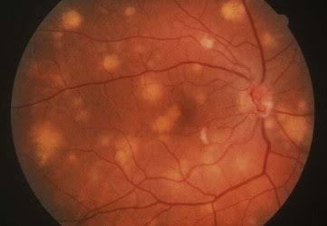
Diffuse choroiditis:
large spreading lesions involving most of choroidal tissue.
Usually tubercular or syphilitic in origin
Disseminated choroiditis:
Characterised by multiple small areas of inflammation scattered over greater part of choroid.
Seen in TB, syphilis
Diffuse choroiditis

Slide 5
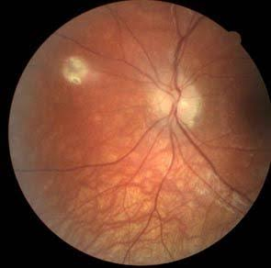
Circumscribed/localised/focal choroiditis:
Characterised by single patch or few patches of choroiditis depending on location of lesion are classified into:
Central choroiditis:
- involves central macular area.
- typical patch of central choroiditis may occur in toxoplasmosis, histoplasmosis, syphilis
Focal choroiditis

Slide 6
Juxtacaecal choroiditis:
Patch of choroiditis involving an area adjoining the optic disc.
Eg: jensens choroiditis in young adults.
Anterior peripheral choroiditis:
Multiple patches of choroiditis seen only in peripheral part of choroid.
Seen in syphilis.
EQUATORIAL CHOROIDITIS: involves choroid in equatorial region

Slide 7
SYMPTOMS:
Defective vision – mild due to vitreous haze
Photopsia- due to irritation of rods & cones
Black spots floating infront of eyes.
metamorphopsia – due to alteration in retinal contour caused by raised patch of choroiditis.
micropsia – due to seperation of visual cells.
Macropsia – due to crowding of rods and cones.
Positive scotoma

Slide 8
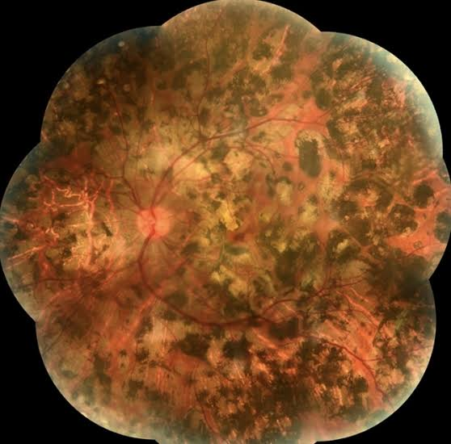
SIGNS:
Vitreous opacities – fine, coarse or snowball opacities due to choroiditis present in middle or posterior part.
Active patch of choroiditis, looks pale or dirty white raised area with ill defined edges.
Healed patch of choroiditis shows sharply,well defined and delineated from normal area due to atrophy of choroidal tissue.
Healed choroiditis

Slide 9
COMPLICATIONS:
Inflammation of anterior uvea
Complicated cataract
Vitreous degeneration
Macular oedema
Retinal detachment

Slide 10
TREATMENT:
Non specific therapy consists of periocular and systemic corticosteroids.
Posterior sub-tenon injections of depot corticosteroids effective in checking acute phase of posterior uveitis.

Slide 11
THANKQ

